Slide 1
Writing p.53

Slide 2
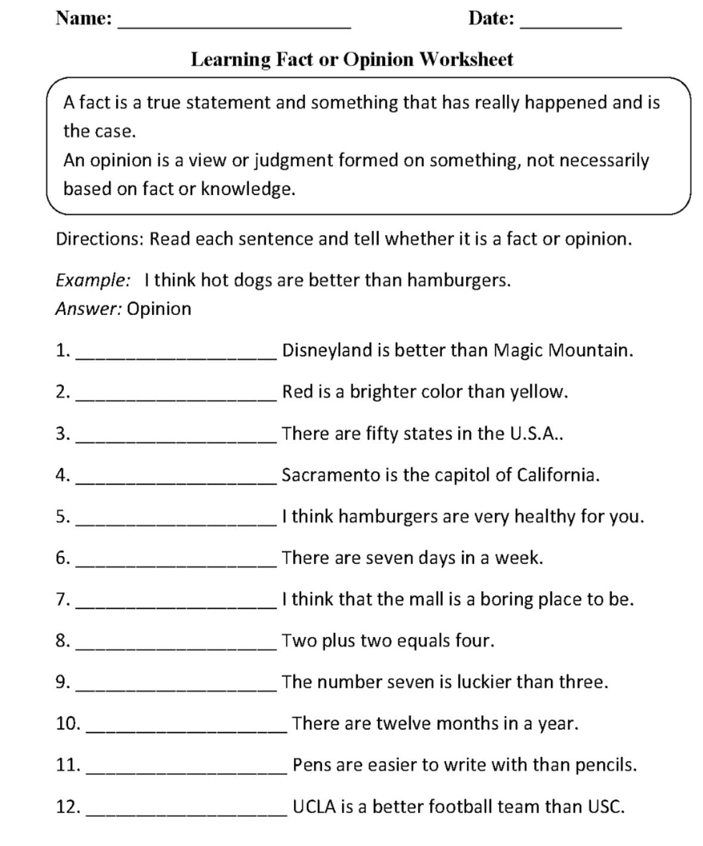

Slide 3
The answers
1.Opinion
2.Fact
3.Fact
4.Fact
5.Opinion
6.Fact
7.Opinion
8.Fact
9.Opinion
10.Fact
11.Opinion
12.Opinion

Slide 4
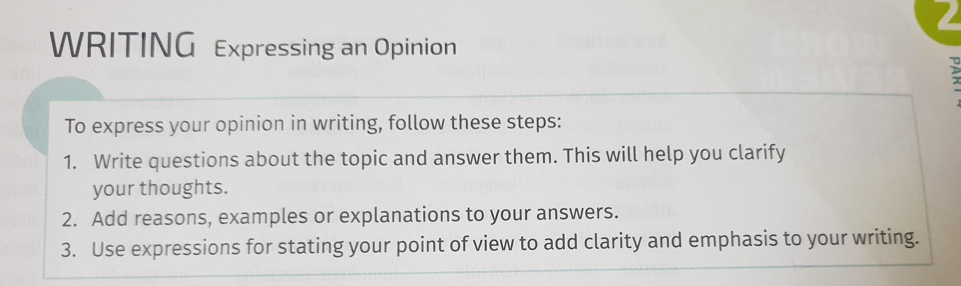

Slide 5
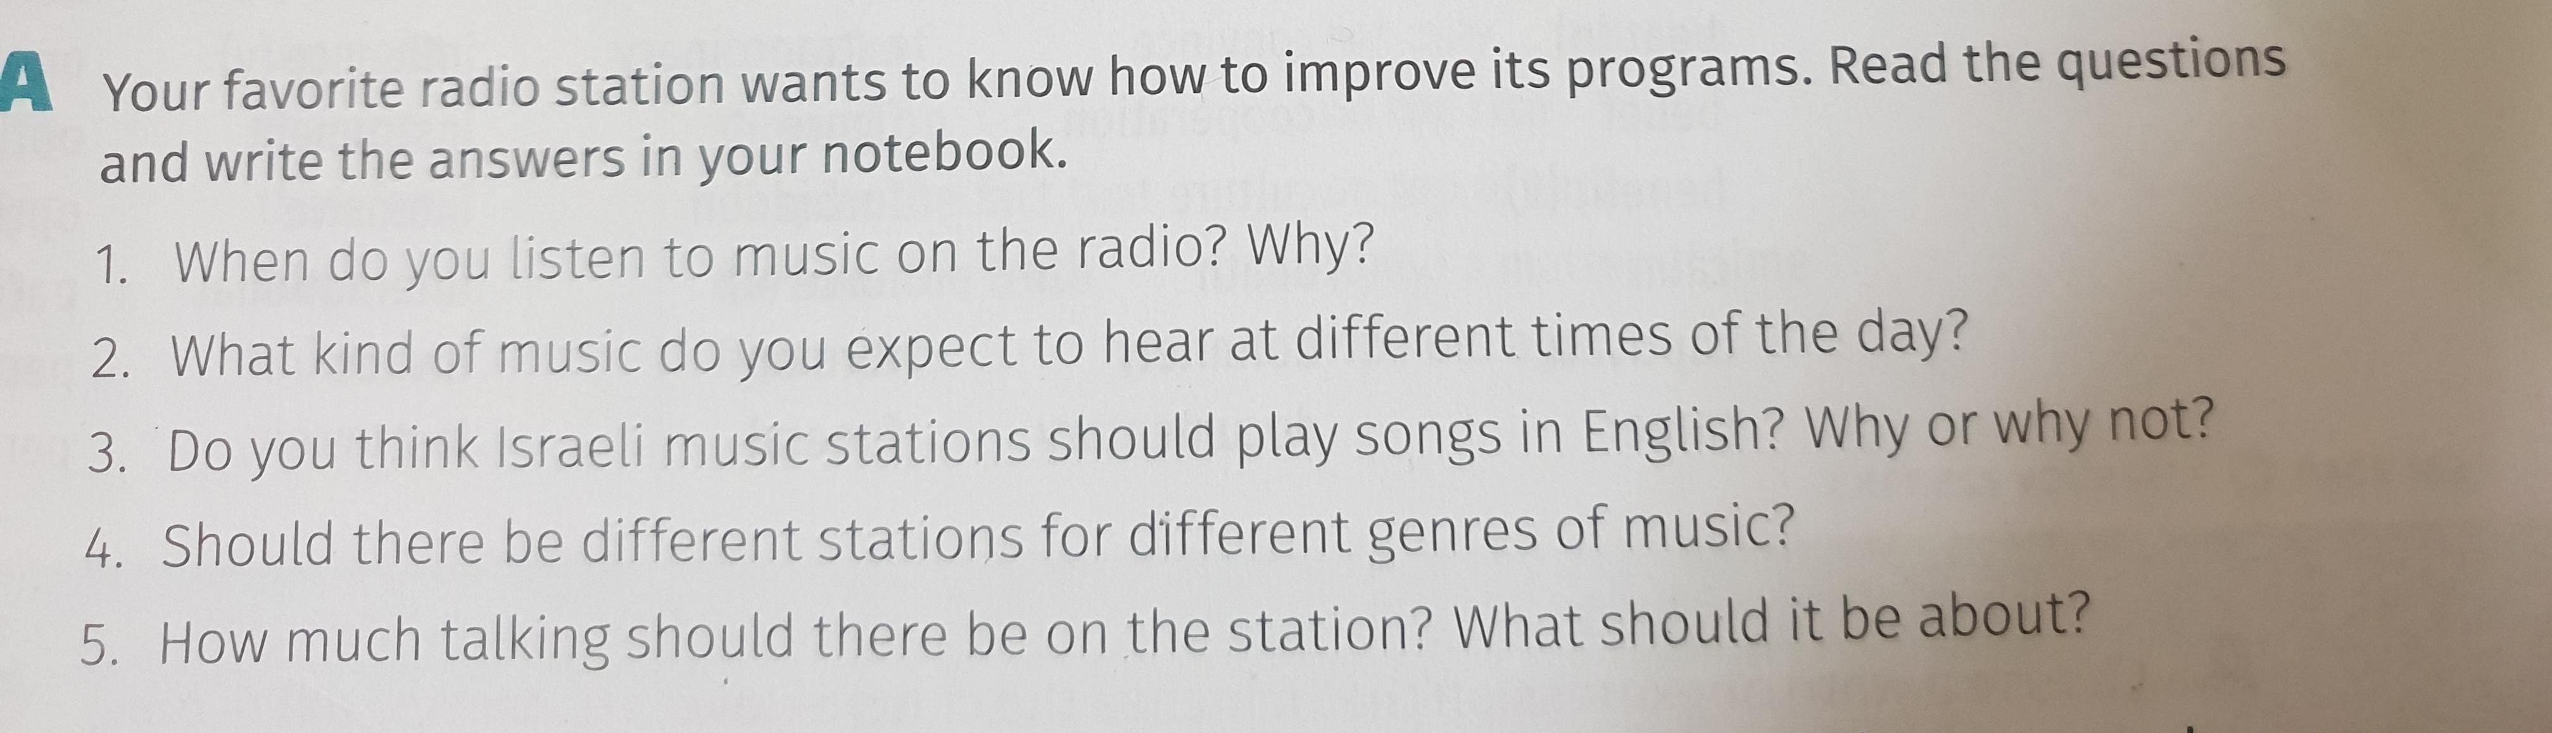
Ex A p.53

Slide 6
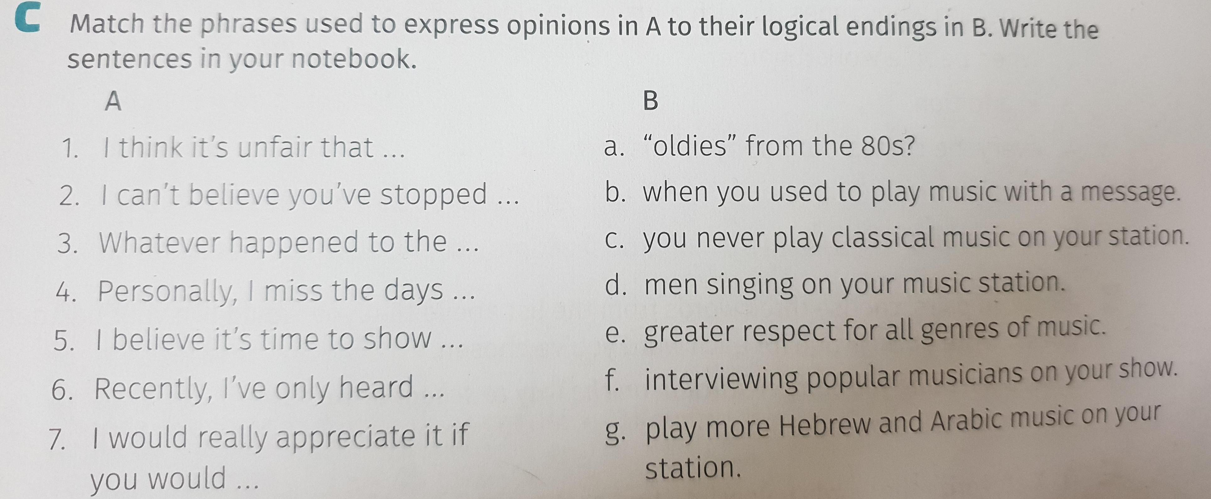
Ex C p.53

Slide 7
