Slide 1
Mystery musician contest part 2

Slide 2
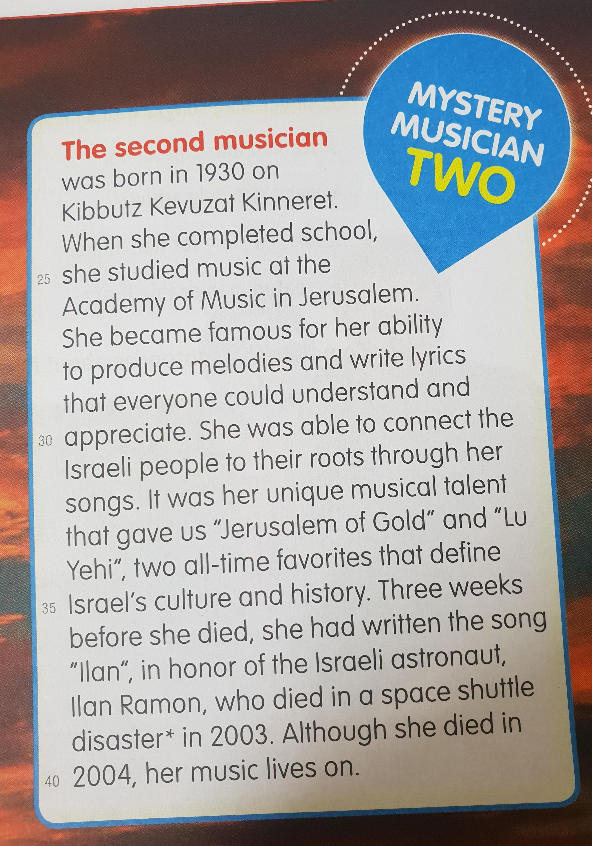

Slide 3
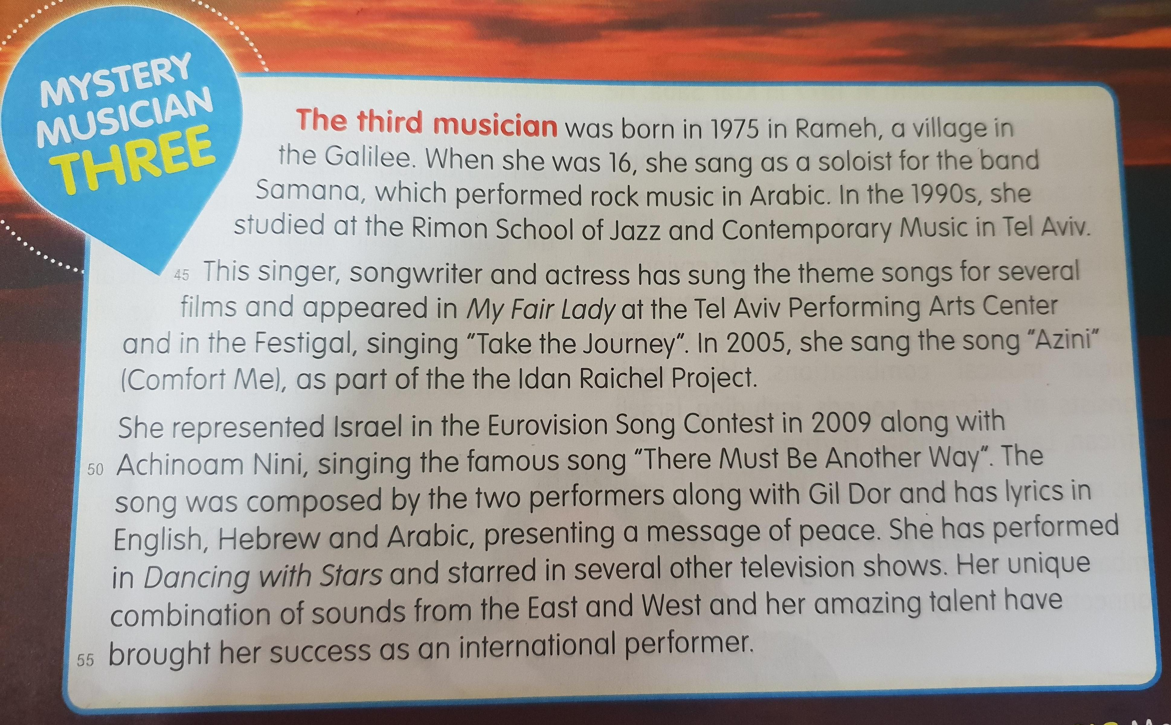

Slide 4
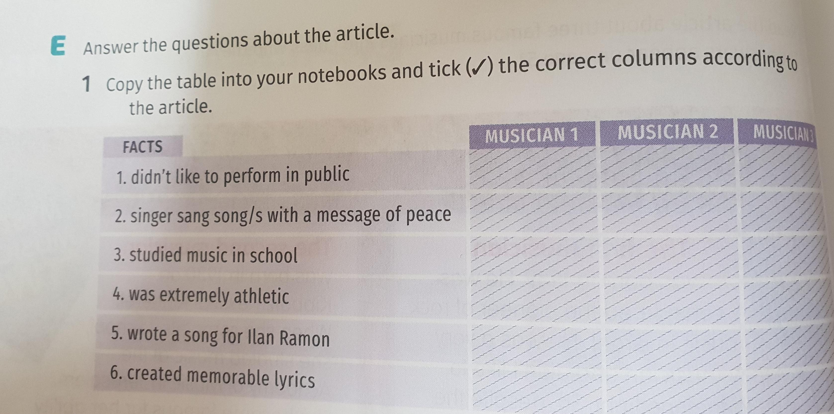
Ex E p.50

Slide 5
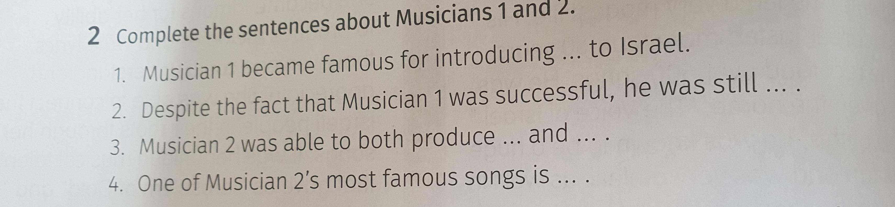

Slide 6
Homework
Please answer the previous slides .

