Slide 1
Writing Expressing an Opinion p.53

Slide 2
What is an opinion
https://youtu.be/KEK2oGBSsHk

Slide 3
https://youtu.be/qv4rHG6rrr8

Slide 4


Slide 5
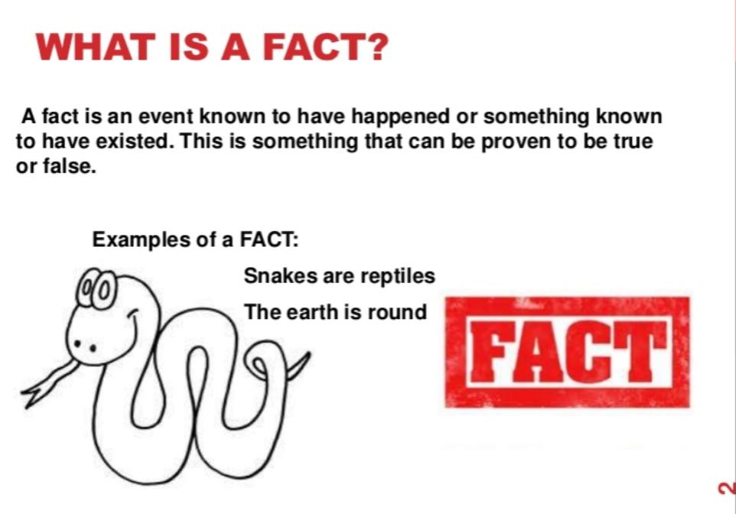

Slide 6
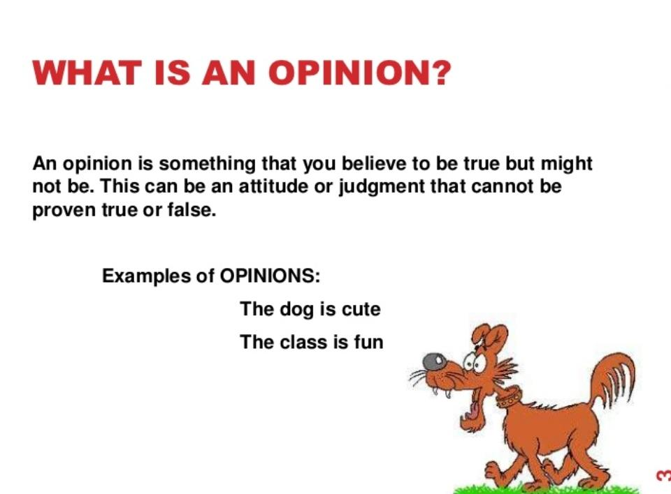

Slide 7
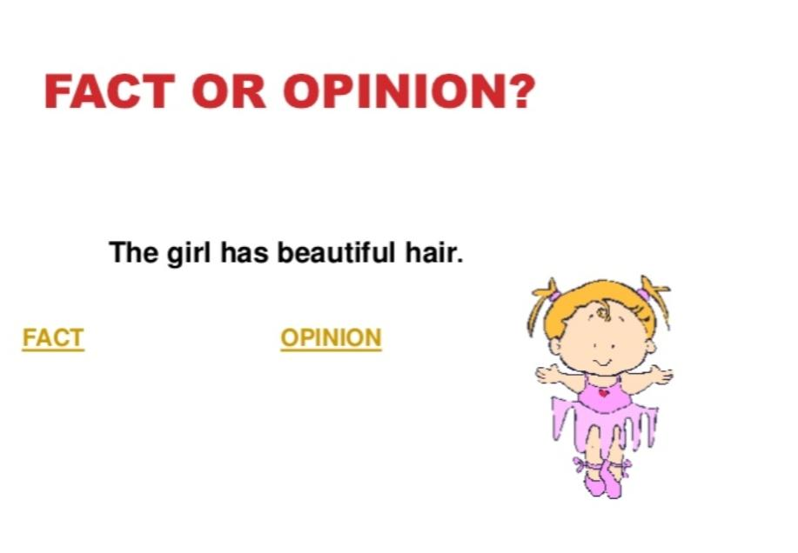

Slide 8


Slide 9
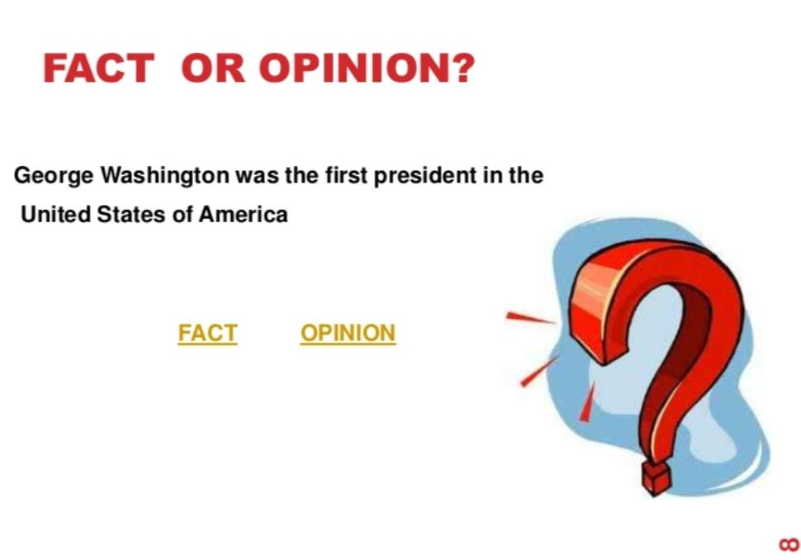

Slide 10
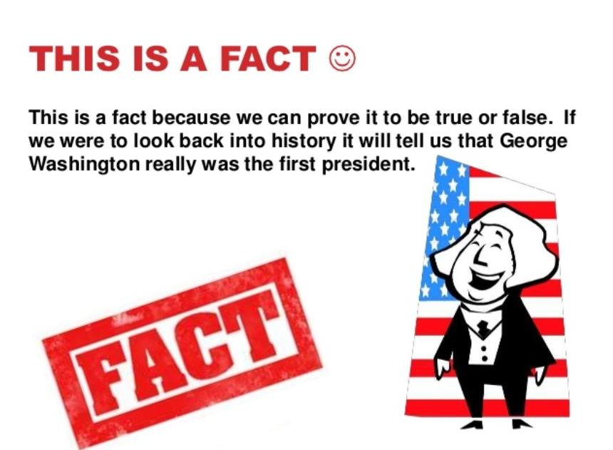

Slide 11
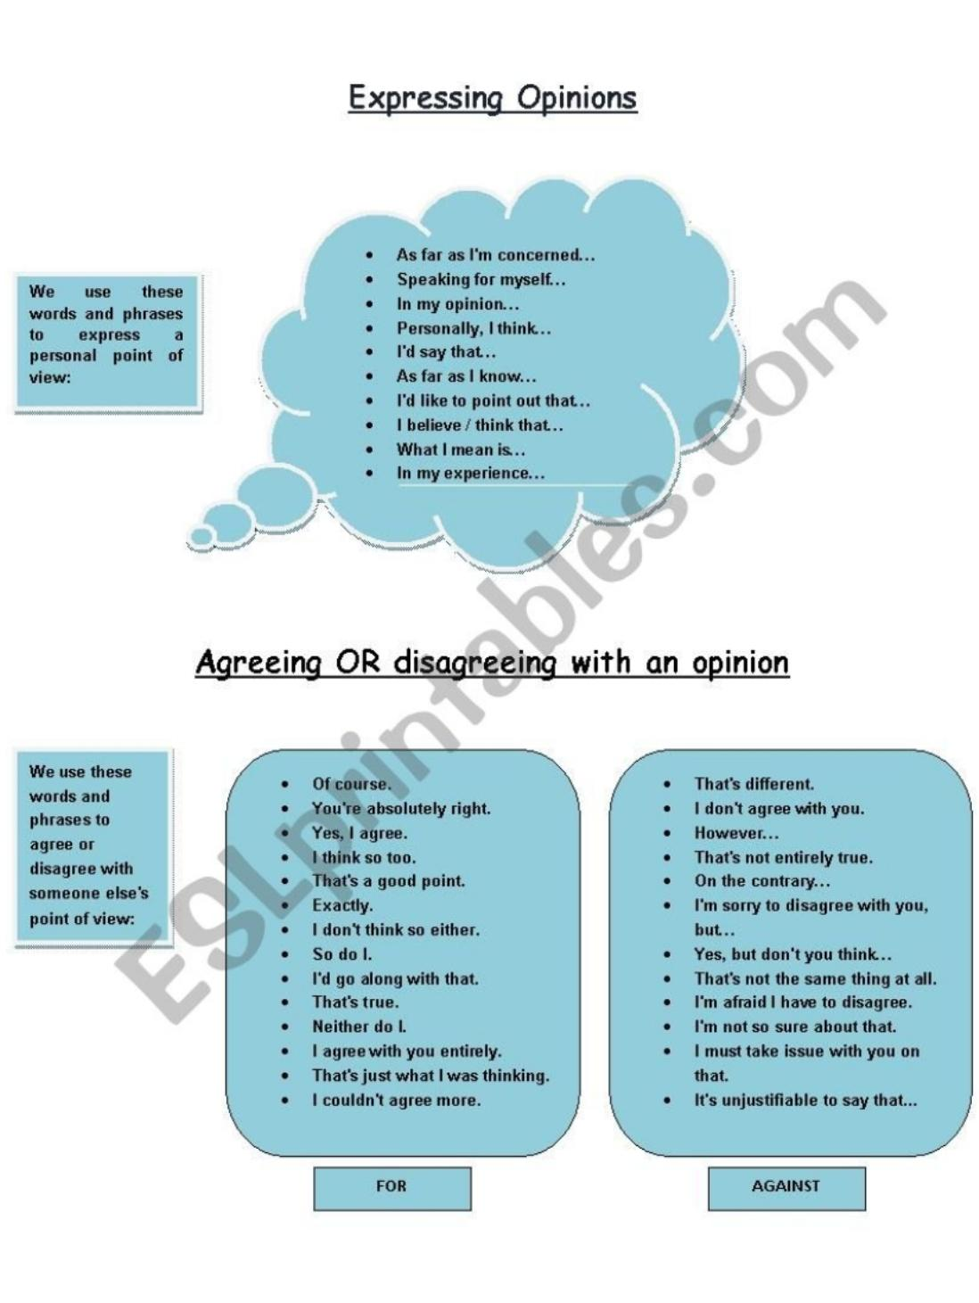

Slide 12
