Slide 1
Mystery musician contest p.49

Slide 3
MYSTERY MUSICIAN ONE AND TWO
Word | Meaning
Was born | ولد
Considered | أعتبر
Modest | متواضع
Lasted | إستمر
Despite of | بالرغم من
Career | سيرة مهنية
Ability | القدرة
Disaster | كارثة
Roots | جذور
Spotlight | دائرة الاضواء

Slide 4
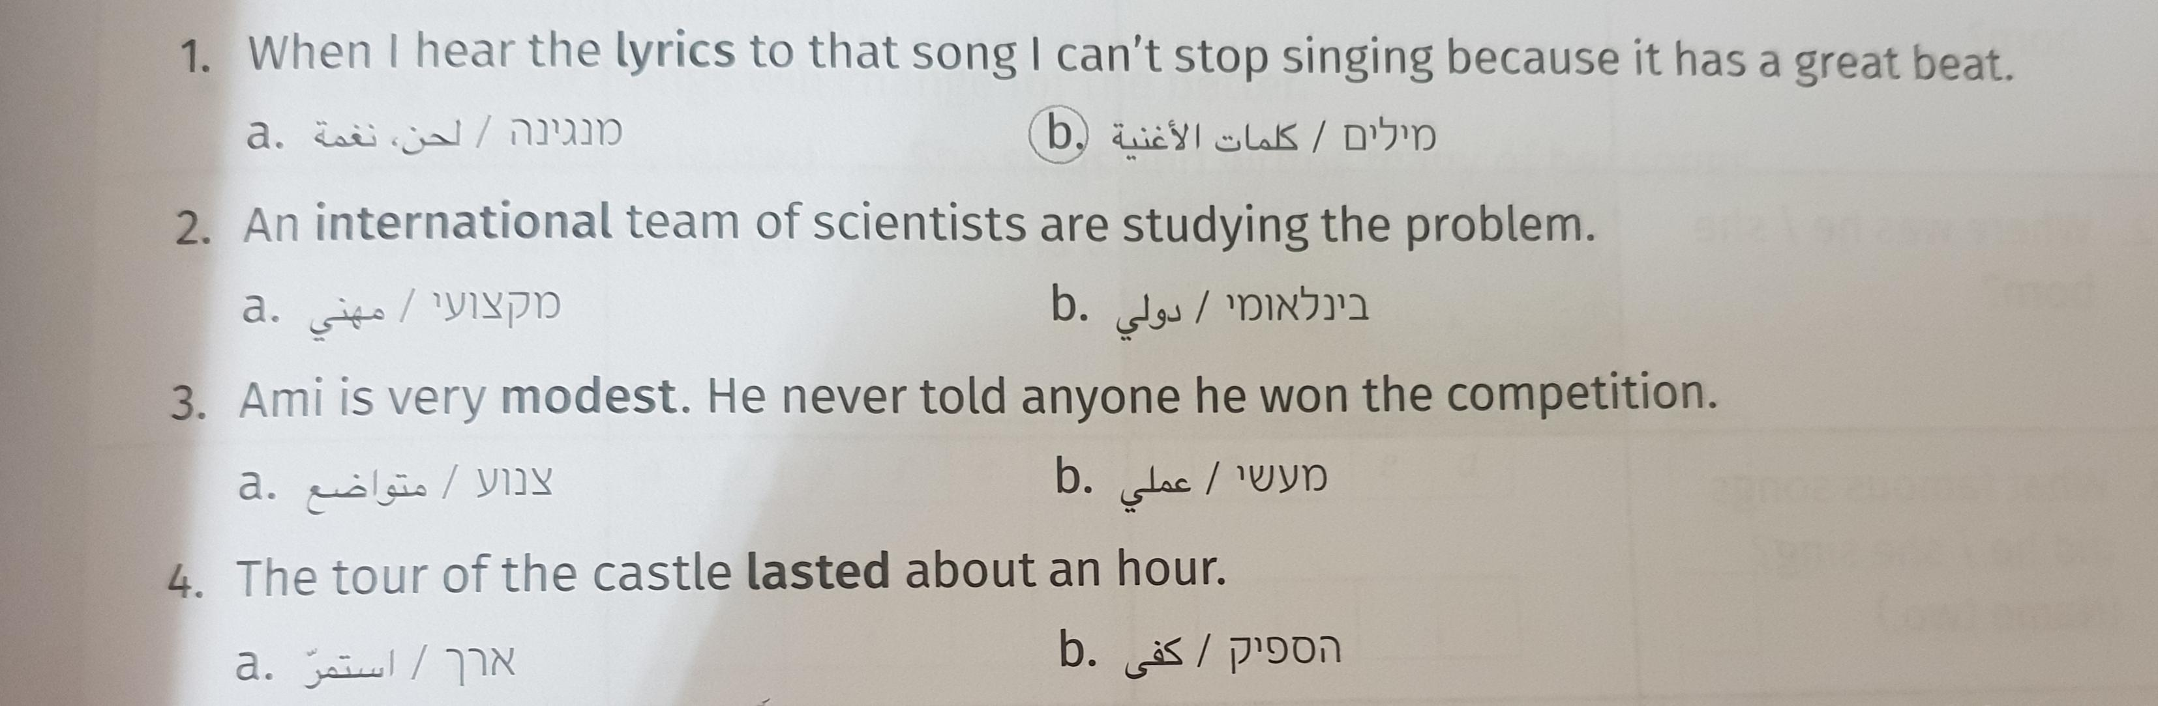
Circle the correct meaning of the words in bold .

Slide 5
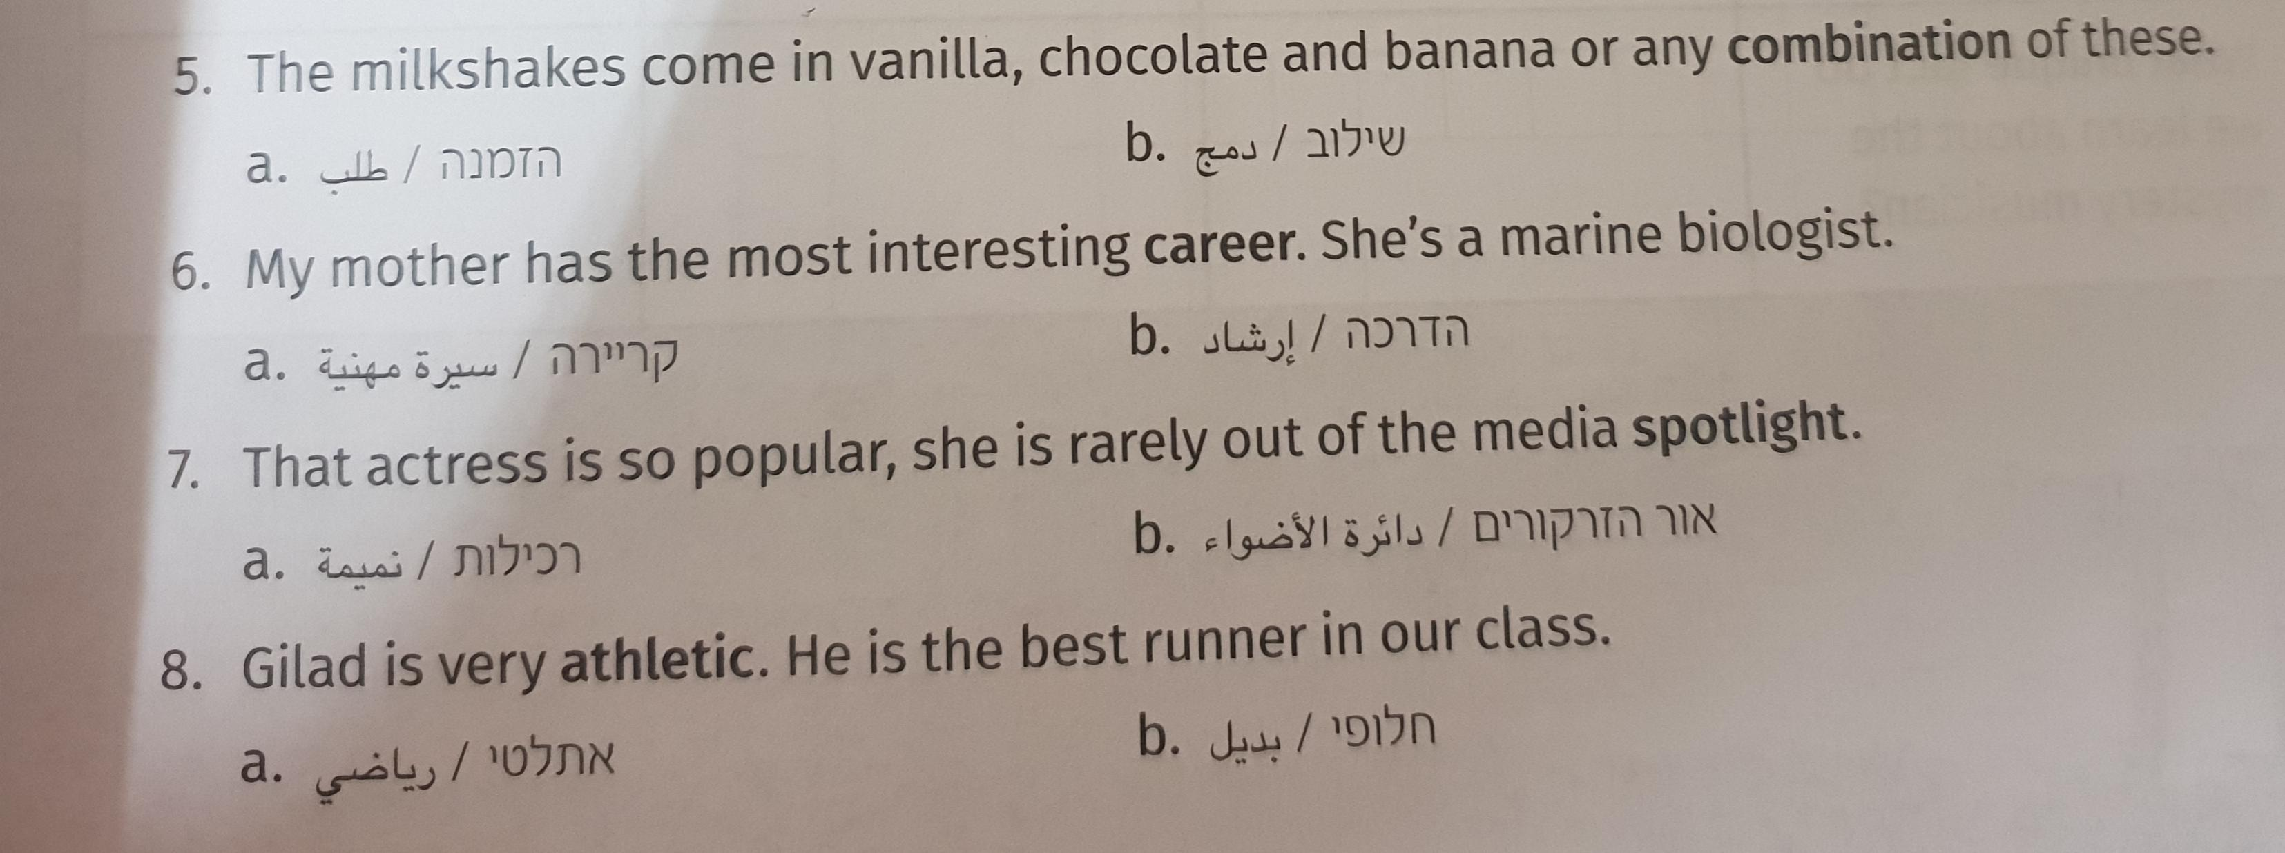
Circle the correct meaning of the words In bold

Slide 6
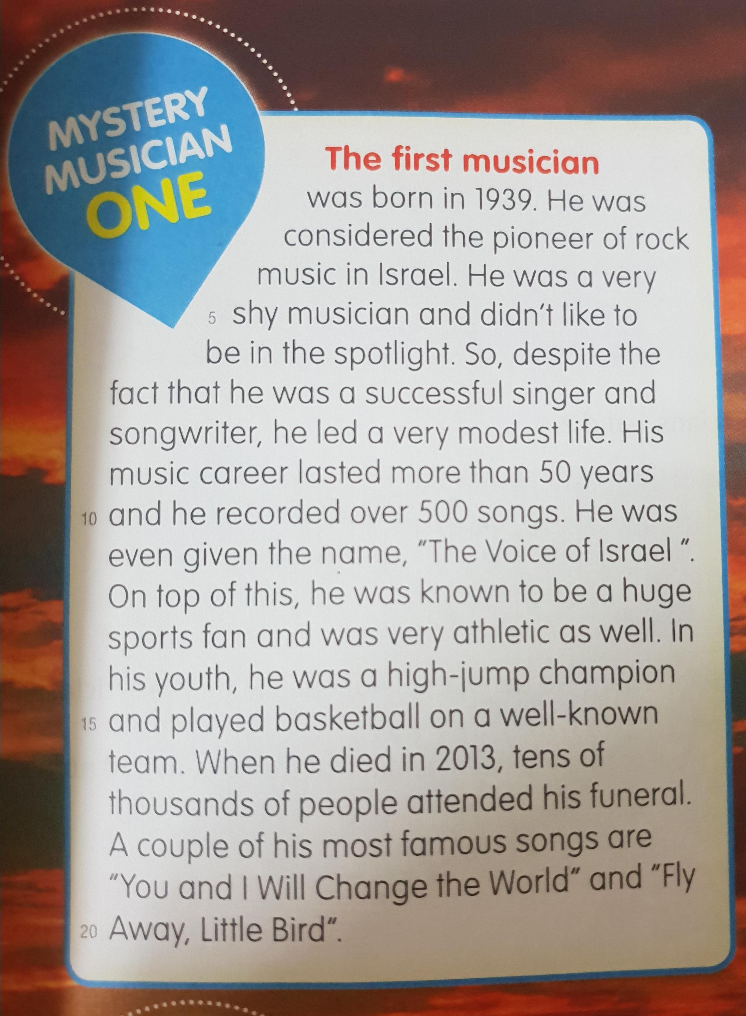
Mystery musician one

Slide 7
Scanning for information
Look for words with capital letters,dates,times and numbers in an article.They will give you information ,such as :who,when where and what .
Look at the text and complete the chart below .
1)When was he/she born?
2)Where was he /she born?
3)What famous songs did he/she sing ?(Name two)

Slide 8
Answers for Ex 1
1.b
2.b
3.a
4.a
5.b
6.a
7.b
8.a

