Slide 1
Vocabulary of Mystery Musician Contest

Slide 2
Write the meaning of the following words
Word | Meaning
Culture
Athletic
Last
Funeral
Word | Meaning
 | متواضع
 | مهنه
 | بطل
 | خطوة

Slide 3
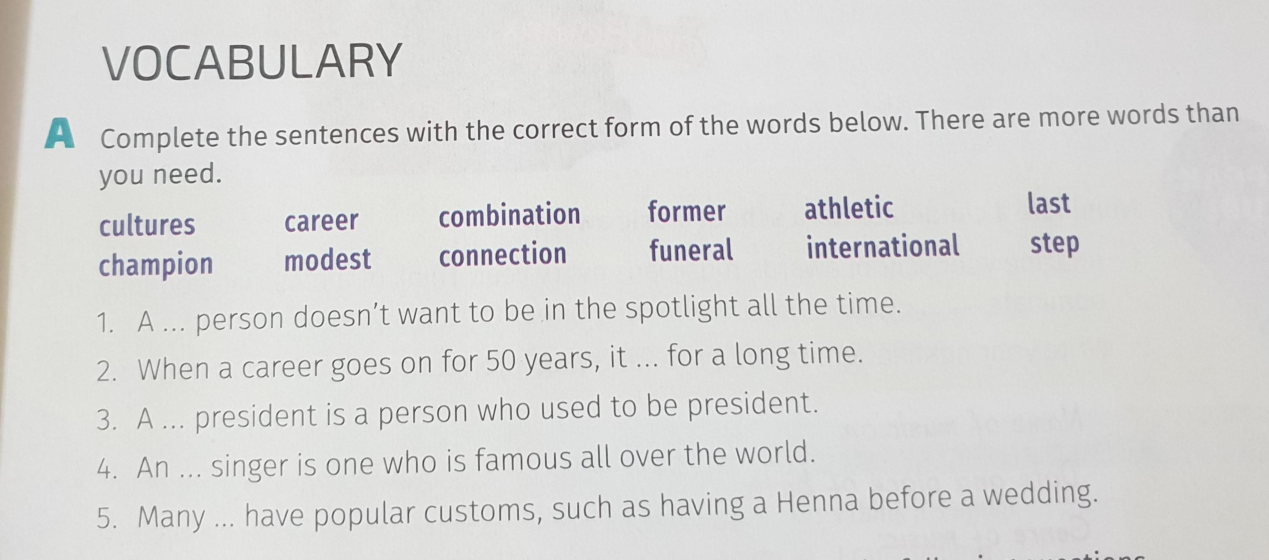
Vocabulary ExA p.51

Slide 4
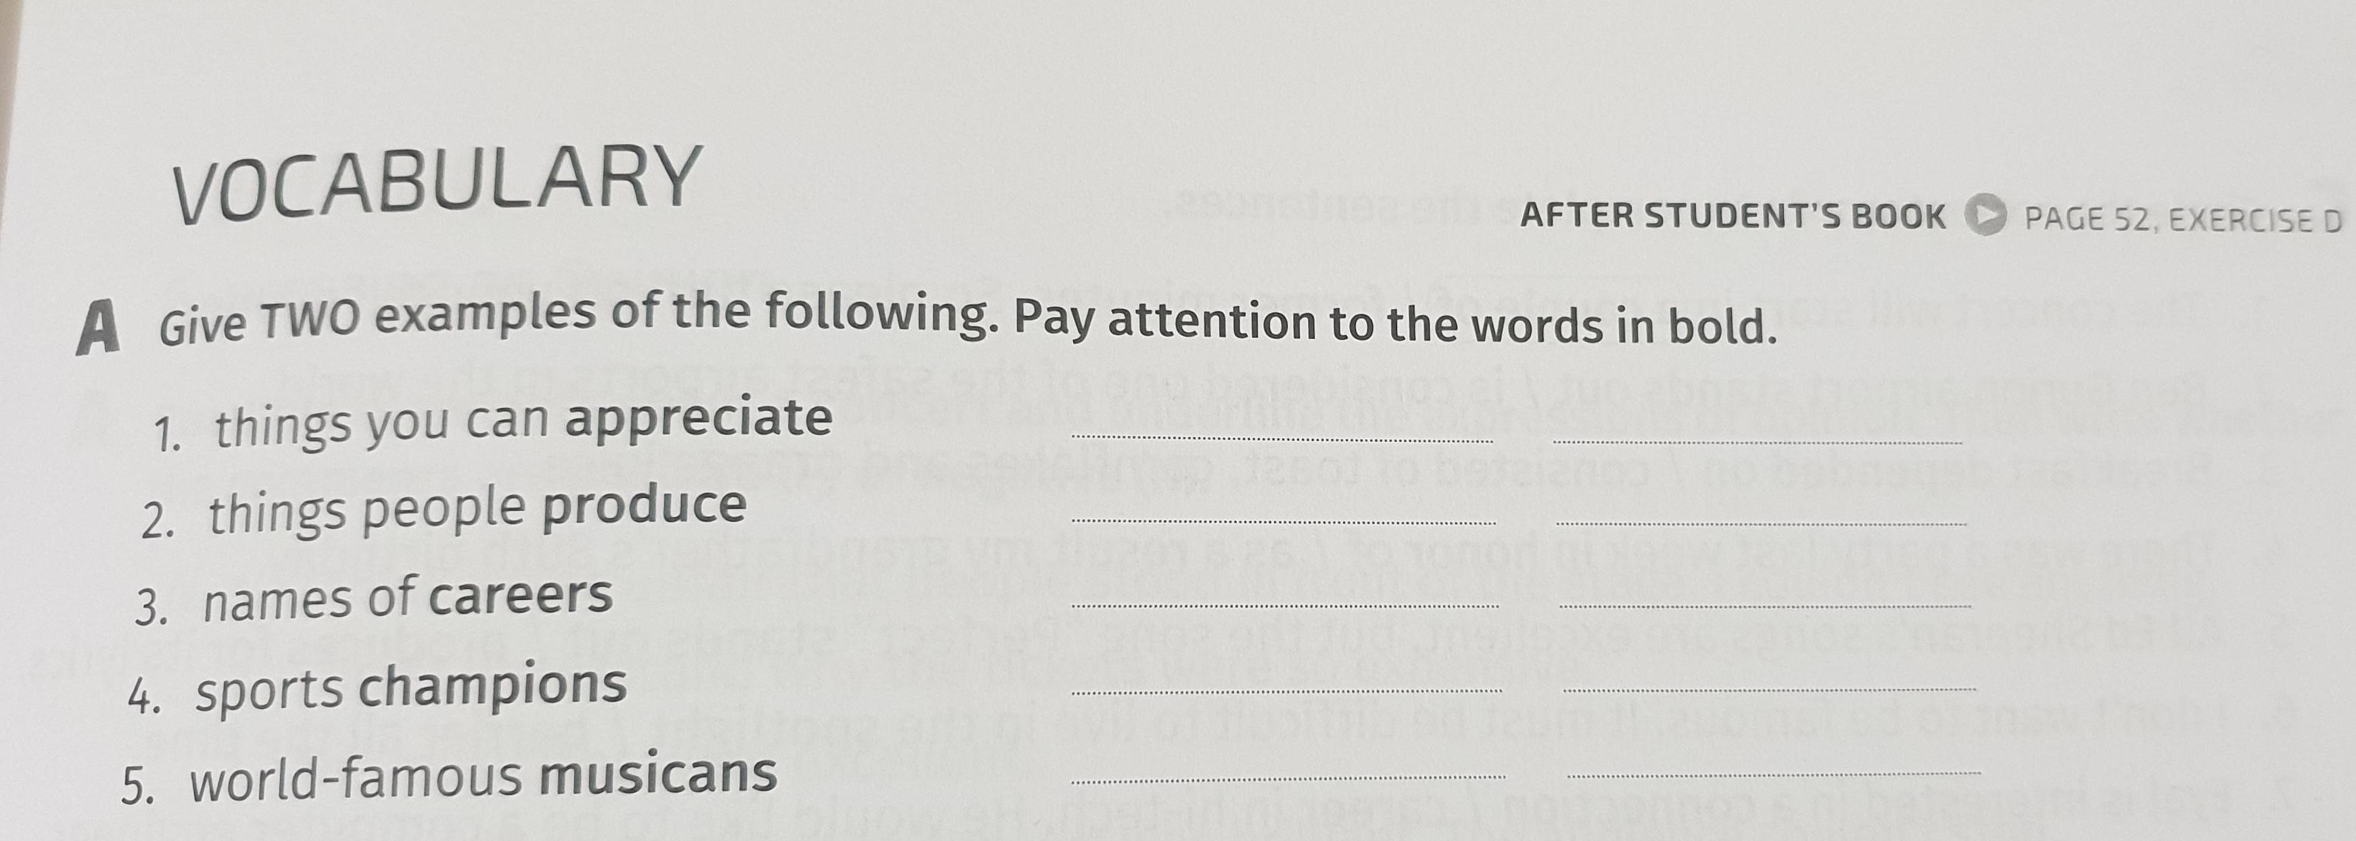

Slide 5
Homework
The vocabulary ex in slide number 4 will be your homework for the next lesson

Slide 6
The answers ….

Slide 7
Write the meaning of the following words
Word | Meaning
Culture | ثقافة /حضارة
Athletic | رياضي
Last | يستمر/مستمر
Funeral | جنازة
Word | Meaning
Modest | متواضع
Career | مهنه
Champion | بطل
Step | خطوة

Slide 8
Answers of Ex A p.51
1.modest
2.last
3.former
4.international
5.cultures

